Slide 1


Udash as the missing link for the type safe web development in Scala
Mateusz Starzec

Slide 2

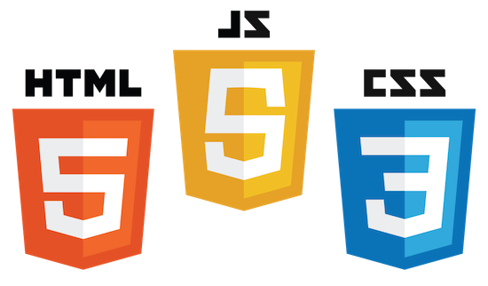

Development stack - typically
Four different languages:
Frontend: HTML, CSS, JavaScript
Backend: Scala
Target:
Frontend: Scala
Backend: Scala
Notes:
Sometimes: JS -> TypeScript / CoffeeScript / Dart

Slide 3
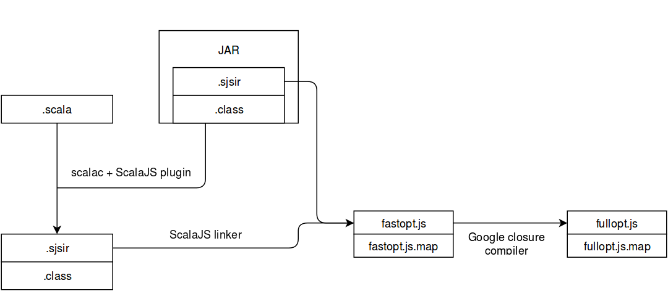
scalac+ Scala.js + linker

Slide 4
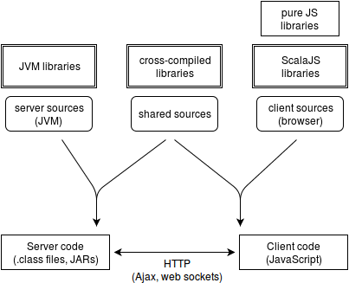
Project structure
Notes:
Shared source - one scala code can be used in both JavaScript and JVM application.

Slide 5
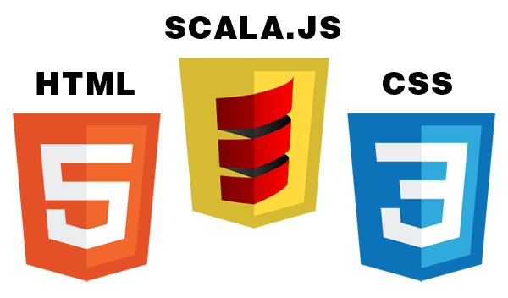
Development stack
We already know how to compile Scala to JavaScript.
What about HTML and CSS?

Slide 6
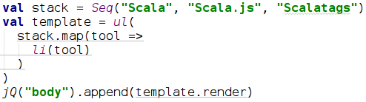
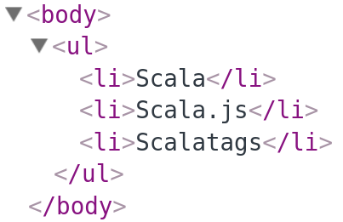
Scalatags
Result:
Notes:
render() creates DOM node which can be displayed by web browser

Slide 7
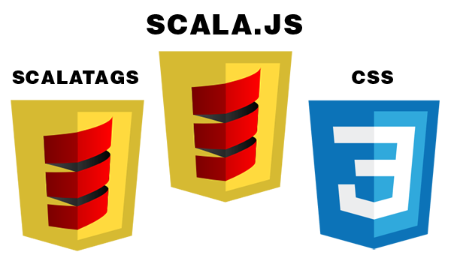
Development stack
Scalatags:
Type-safe API for a dynamic HTML generation in Scala.js
Powerful templating tool
It's Scala!

Slide 8
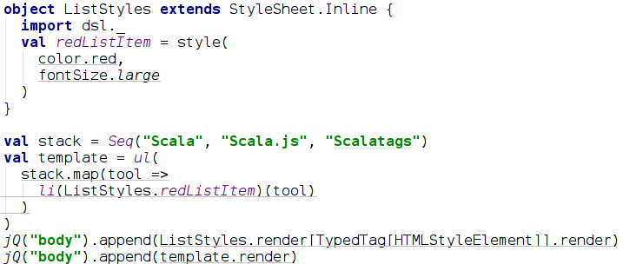
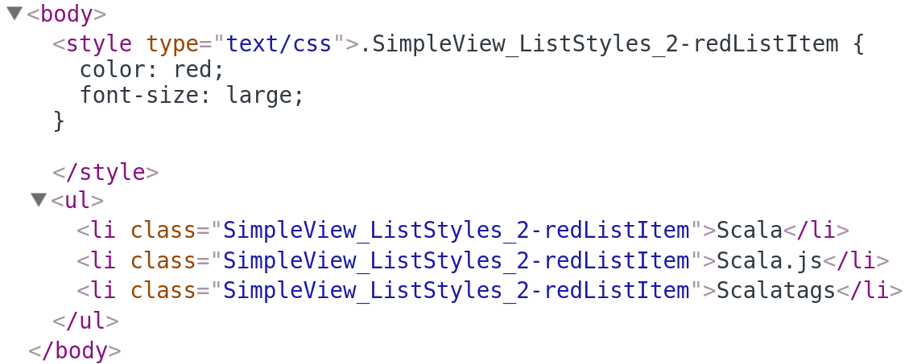
ScalaCSS
Notes:
* typed DSL
* easy usage search
* built in minification

Slide 9
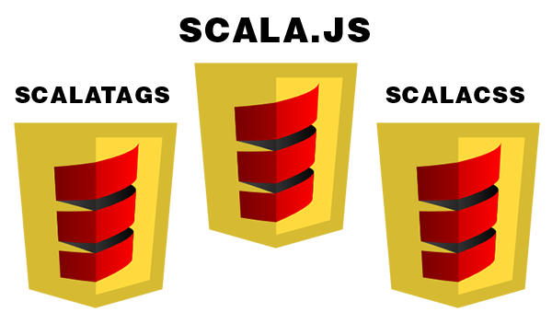
Development stack
ScalaCSS:
Type-safe API for a dynamic CSS generation in Scala.js
Mixins, conflict detection
Great IDE support

Slide 10
Development stack
Now we have only one language in the backend and the frontend application.
What about:
data bindings?
frontend routing?
client ↔ server communication?
i18n?

Slide 11

Udash Framework
The Udash modules:
Udash Core
Udash RPC
Udash i18n
Notes:
Core - everything what typical frontend application needs (eg. data bindings, routing, MVP utils)
RPC - typesafe client-server communication system
i18n - i18n supports for Udash based applications
Auth - utils for authentication and authorization with Udash RPC
Bootstrap - wrapper for Twitter Bootstrap library, using Udash bindings Material UI - wrapper for Google Material library, using Udash bindings

Slide 12
Udash Core - Properties
The Udash data model system:
Property – contains single, immutable value
ModelProperty – complex structure containing other properties
SeqProperty – sequence of the properties
Features:
Value change listeners
Asynchronous validation
Transformation and SeqProperty filtering

Slide 13
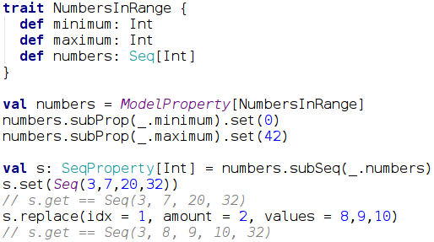
Udash Core - Properties

Slide 14
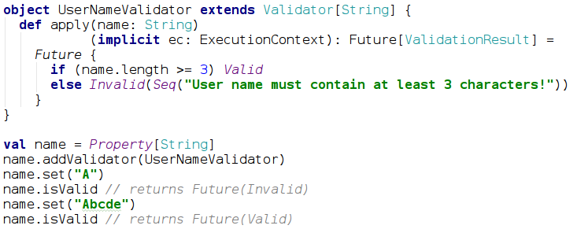
Udash Core - Properties

Slide 15
Udash Core - Properties
Properties Demo

Slide 16
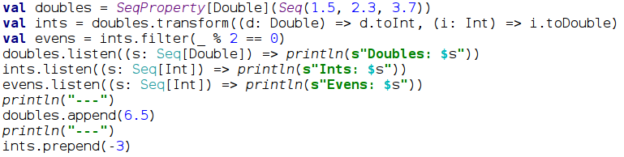
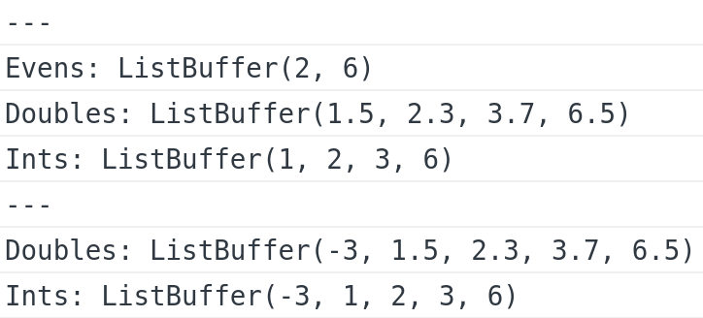
Udash Core - Properties
Prints out:
Notes:
* listeners are async
* bidirectional transformation creates editable property (there are unidirectional transformations which creates read-only property)
* transformed and filtered properties are automatically synchronized with the original property

Slide 17
Udash Core - Properties
Advanced Properties Demo

Slide 18
Udash Core - Bindings
Binding Properties into the Scalatags templates:
Automatically updates presented element after property change
Binds property value into DOM element attribute
Binds property validation result
Binds user input from form elements into properties

Slide 19
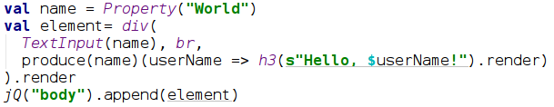
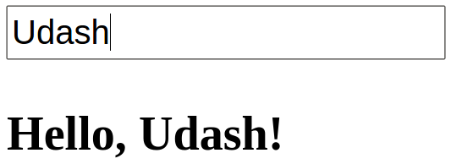
Udash Core - Bindings
Result:
Notes:
TextInput - creates text input binded with property value (changes are synchronized in the both directions)

Slide 20
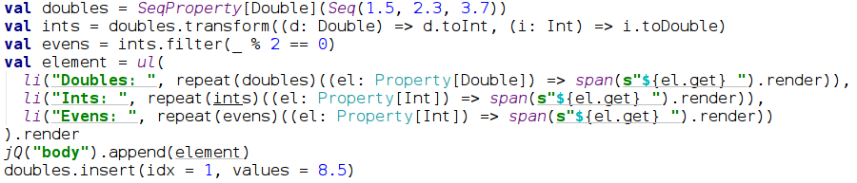
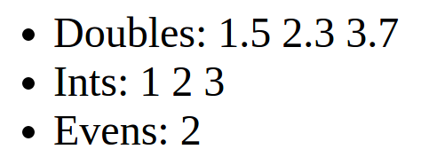
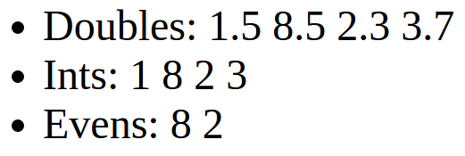
Udash Core - Bindings
Result:

Slide 21
Udash Core - Bindings
Binding Demo

Slide 22
Udash Core - Application
Starting point of the frontend code
Application::run(attachToElement: dom.Element)
Resolves the initial application state and view
Adds resolved view to the DOM hierarchy as a child of the provided node
The root node has to be present in the bootstrapping HTML

Slide 23
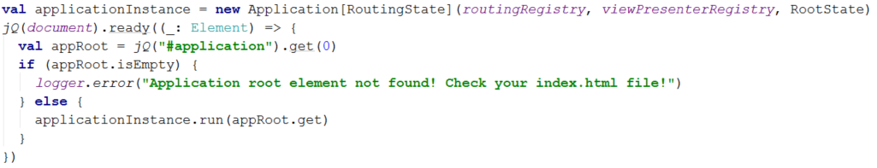
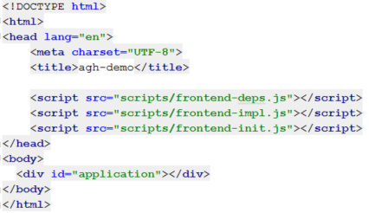
Udash Core - Application

Slide 24
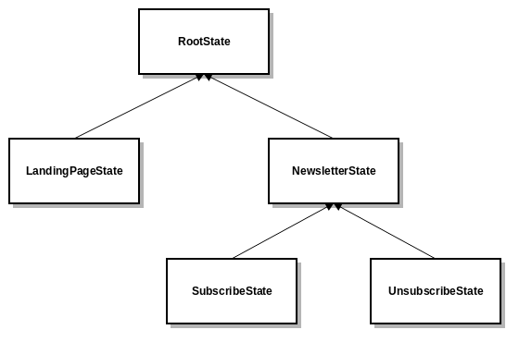
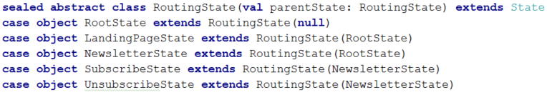
Udash Core - State
Type-safe equivalent of the URL
Hierarchical structure
Views resolving is based on the states

Slide 25
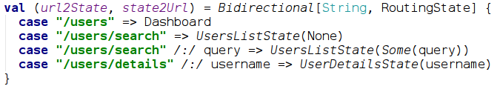
Udash Core - Routing
Routing based on the URL part following # sign
Resolves an application state basing on the URL
Resolves a view basing on the state

Slide 26
Udash Core – Application & Routing
Application & Routing Demo
Notes:
Files:
states.scala
RoutingRegistryDef.scala
StatesToViewPresenterDef.scala
init.scala

Slide 27
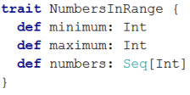
Udash Core - Views
Typical view has:
Model structure definition

Slide 28
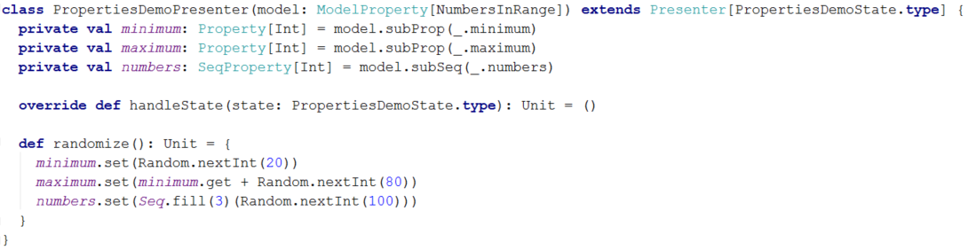
Udash Core - Views
Typical view has:
Model structure definition
Presenter – business logic

Slide 29
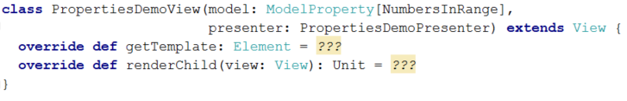
Udash Core - Views
Typical view has:
Model structure definition
Presenter – business logic
View – Scalatags template, child view rendering

Slide 30
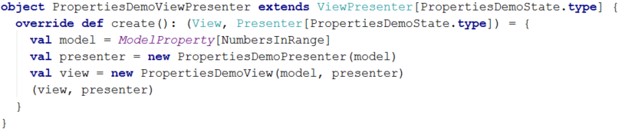
Udash Core - Views
Typical view has:
Model structure definition
Presenter – business logic
View – Scalatags template, child view rendering
ViewPresenter – factory of the model, the view and the presenter

Slide 31
Udash Core – Views
Views Demo
Notes:
Files:
PropertiesDemoView.scala – model, view, presenter and factory
RootView.scala – child rendering

Slide 32
Udash Core
Summary:
Strongly typed web framework
Asynchronous design
Written in Scala.js
Open source

Slide 33
Udash RPC
Client ↔ server communication system:
Works in the both directions out of the box
Asynchronous by default
Crosscompiled traits describing the RPC interface
Strongly typed interfaces, checked in compile time
Usage looks like standard method call
Based on the websocket

Slide 34
Udash RPC - Interfaces
Methods exposed by the RPC interface can be:
Calls - methods returning Future[T] where T is a serializable type (a client RPC interface cannot expose those methods)
Fires - methods with a return type Unit there is no guarantee that your request will be received by a recipient
Getters - methods returning another RPC interface, calling this method does not send anything over the network

Slide 35
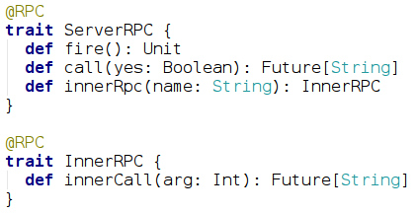
Udash RPC - Interfaces
Shared:
Notes:
Both the server and the client RPC interfaces are defined in a shared module and compiled to JS and JVM.

Slide 36
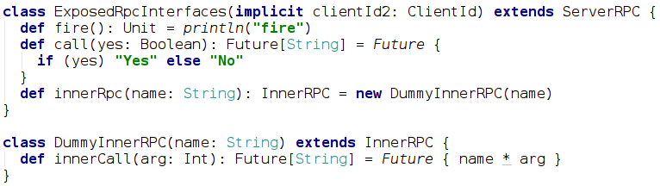
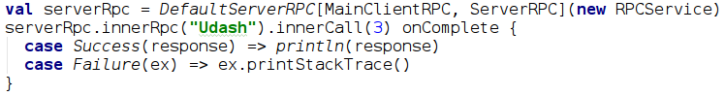
Udash RPC – client calls server
Server-side implementation:
Client-side call:

Slide 37
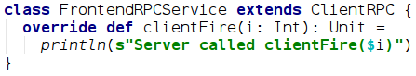
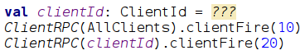
Udash RPC – server calls client
Client-side implementation:
Server-side call:

Slide 38
Udash RPC
Server↔Client RPC Demo
Notes:
Files:
MainClientRPC.scala & MainServerRPC.scala – RPC interfaces
ExposedRpcInterfaces.scala – backend implementation
ApplicationServer.scala – atmosphereHolder
RPCService.scala – frontend implementation
init.scala – Context.serverRpc – frontend handler of the server connection

Slide 39
Udash i18n
Typed translation keys arguments
Two ways of translations providing:
Compiled into frontend JavaScript code
Served by backend application via RPC (with frontend caching)
Property-based translation binding – dynamic language change

Slide 40
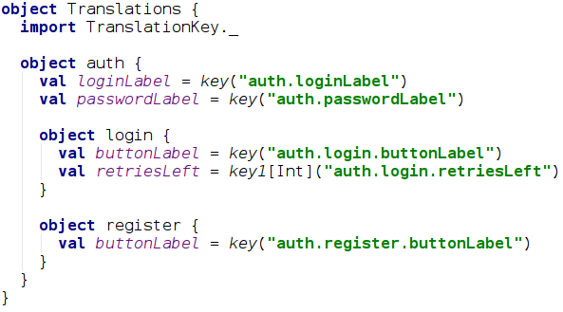
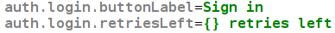
Udash i18n
Templates:

Slide 41
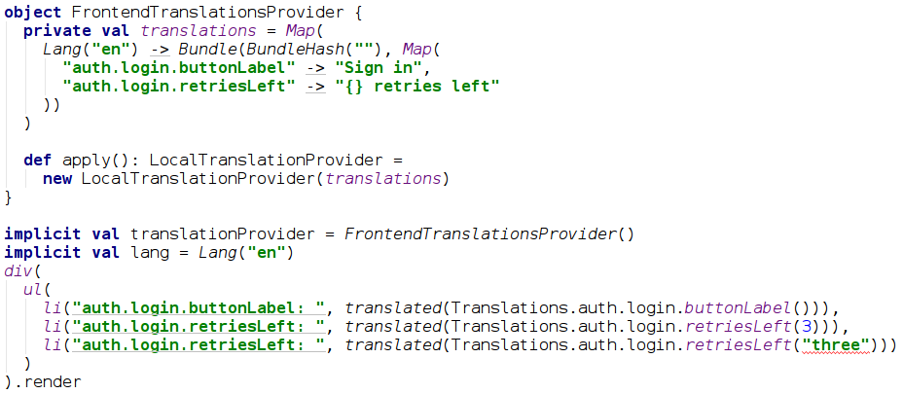
Udash i18n
Usage:

Slide 42
Udash i18n
Translation Demo
Notes:
Files:
MainServerRPC.scala – translations subinterface
ExposedRpcInterfaces.scala – backend implementation
ApplicationServer.scala – atmosphereHolder
RPCService.scala – frontend implementation
init.scala – Context.serverRpc – frontend handler of the server connection

Slide 43
Udash Generator
Quickly bootstrap Udash based project:
Generator creates full, ready to compile project
You can select which libraries you want to use
Udash
Udash RPC
ScalaCSS
Jetty

Slide 44
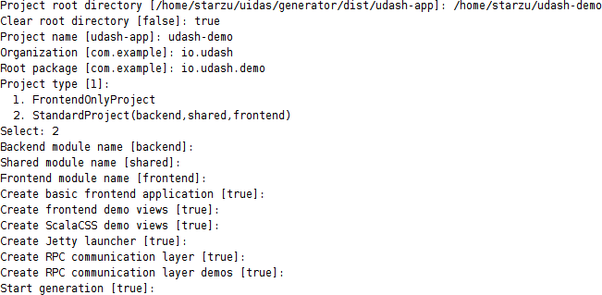
Udash Generator

Slide 45
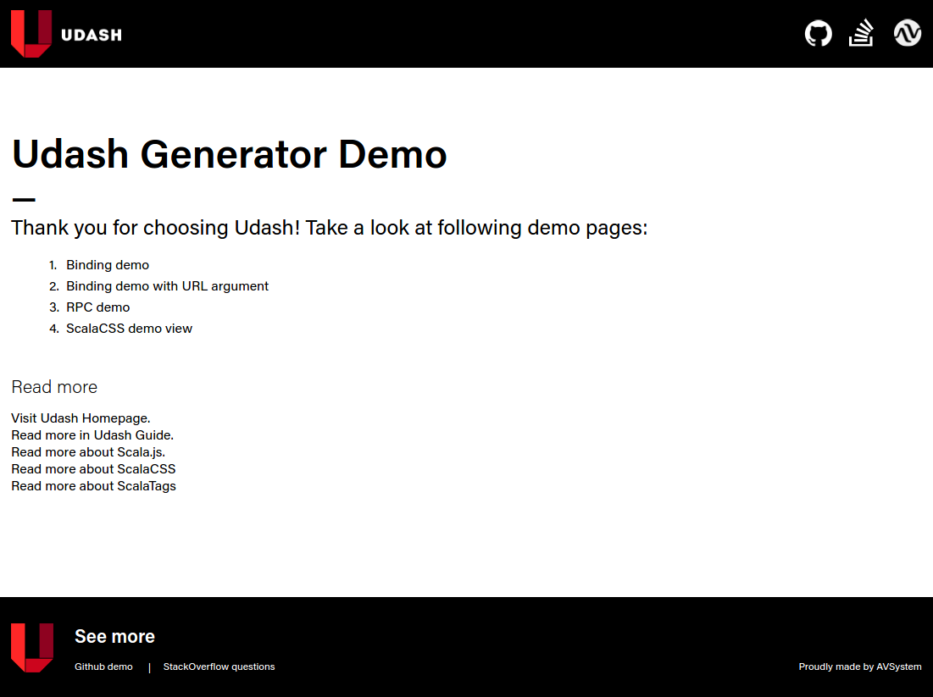
Udash Generator

Slide 46
Summary
Scala everywhere + shared code
Types wherever possible
Quick bootstrapping
Easy development
Notes:
Scala everywhere - it's possible to develop the frontend and the backend with Scala. It's also possible to share code between these two applications.
Types wherever possible - everything is types: DOM hierarchy, styles, frontend data model, translations, client-server communication...
Quick bootstrapping - Udash Generator allows you to create, compile and run Scala.js based project in 5 minutes
Easy development - great IDE support, a lot of utils for common web application development issues

Slide 47
Thank you

